Slide 1

UE20CS334 Natural Language Processing Project EMOTION-BASED MUSIC RECOMMENDATION SYSTEM
Presented by
N Shreelekha –PES1UG21CS353
Mridvi Sharma – PES1UG21CS343
Aditi M – PES1UG21CS901
Department of Cse
Pes university
Under the guidance of
Dr. MAMATHA.h.r
Dr. preethi p
professor
Department of Cse
Pes university

Slide 2
Introduction
In a digital era filled with music options, users struggle to find tunes that align with their emotions. Our project introduces a text-based music recommendation system, using natural language processing to redefine personalized music discovery.

Slide 3
Problem Identified
In today's digital age, the sheer abundance of music available at our fingertips presents a challenge: despite the vast selection, many users struggle to find music that resonates with their current emotional state.
This disconnect between the user's emotions and music selection poses a significant problem in the realm of digital music consumption.
This gap between the availability of music and its relevance to users' emotional states highlights the inadequacies of current music recommendation systems.
Despite the wealth of data and algorithms at their disposal, these systems often prioritize popularity and generic trends over the nuanced emotional needs of individual listeners.

Slide 4
Evidence of Problem
Limitations of the current system: Mainstream music streaming services often prioritize popular tracks or cater to broad demographics, neglecting individual preferences and emotional needs.
Lack of emotional understanding: Existing recommendation algorithms largely focus on user history and listening patterns, overlooking the emotional dimension of music selection.
Research: Studies in psychology and musicology consistently demonstrate the significant impact of music on emotions and mood regulation.
User reports: Many music listeners express difficulty finding songs that match their current mood, highlighting a need for improvement.
Improved Well-being: Music aligned with mood can be more emotionally impactful and enjoyable. Music can influence mood positively, potentially aiding relaxation, motivation, or emotional regulation.

Slide 5
Problem Statement
In today's digital age, the integration of artificial intelligence (AI) technologies has become increasingly prevalent in various aspects of daily life. However, existing recommendation systems often lack the ability to dynamically adapt to users' emotional states in real-time.
The aim of this project is to develop a solution that addresses this gap by creating an Automated Sentiment-Based Song Recommendation System. This system will employ a chatbot interface to engage users in natural language interactions, allowing them to express their sentiments and share insights about their daily experiences.

Slide 6
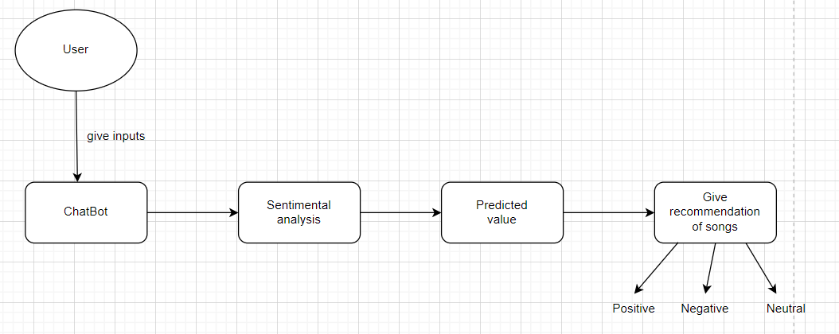
Flowchart

Slide 7
Methodology
BERT Model: We utilize the BERT (Bidirectional Encoder Representations from Transformers) model for sentiment analysis. Specifically, we use the bert-base-uncased model, pre-trained on large corpora, and fine-tuned for sequence classification tasks.
Tokenizer: The BERT tokenizer is used to preprocess user input and convert it into tokenized format suitable for input into the BERT model.
Chatbot Response: Based on the sentiment analysis results, a chatbot response is generated using pre-defined response templates. The chatbot engages in a conversation with the user, providing relevant information or prompting for further interaction.
Keyword Extraction: Keywords are extracted from the user input using spaCy, a natural language processing library. These keywords are used to identify user preferences such as music genre and language.
Song Filtering: The system filters the song dataset based on user preferences and selects a set of songs matching the criteria. The selected songs are then presented to the user as recommendations.

Slide 8
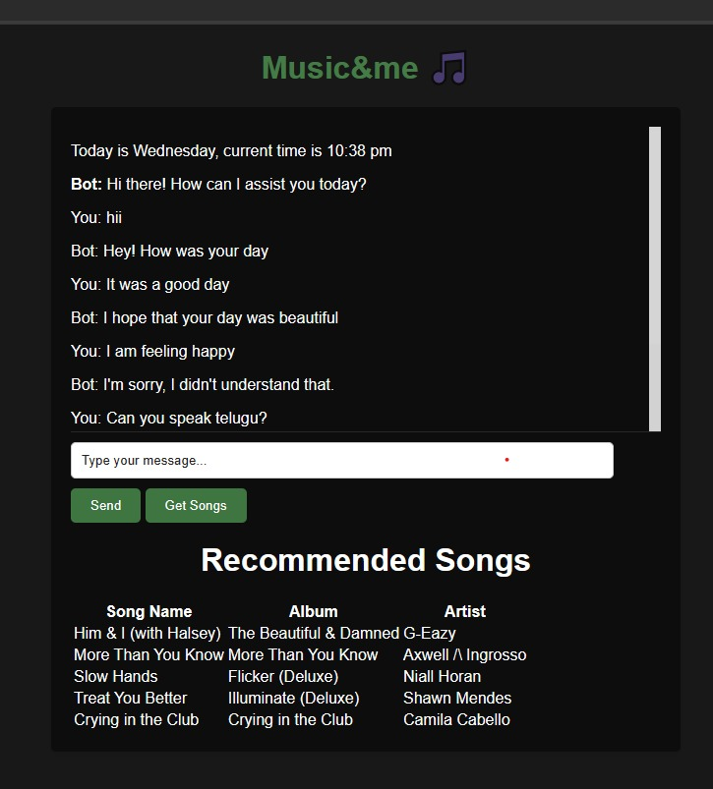
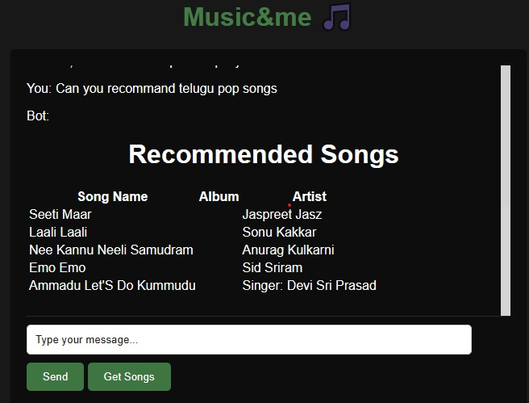
Output

Slide 9
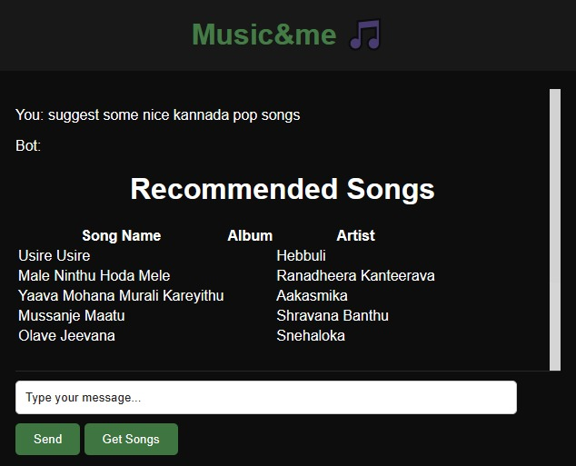
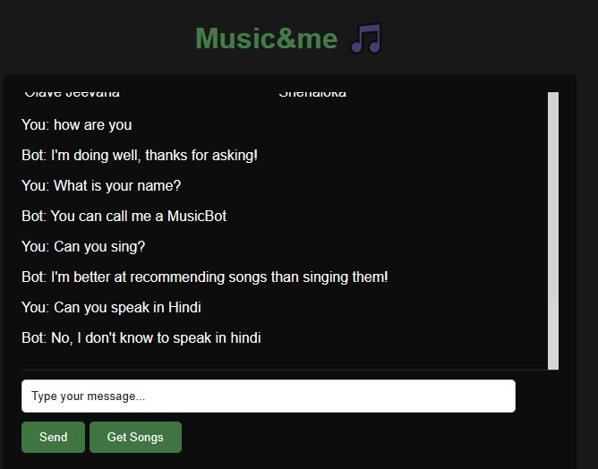

Slide 10
Thank You

